Slide 1
Paris Housing Prediction using multiple regression
Student Name: Nikki Shrestha
Id No.: 010756950
Mentor:Daniel Smith
Date: 07/24/2023

Slide 2
Introduction
Name: Nikki Shrestha
Program: Master of Science in Data Analytics
Education: Master of Business Administration in Information Technology (MBA-IT)
University: Indian Institute of Information Technology- Allahabad (IIIT-A)

Slide 3
Problem and hypothesis
Research question
“To what extent the variables such as number of rooms, has pool, has storm protector, basement etc statistically significant to predict the price of the house?”
Alternate Hypothesis-
Variables are statistically significant to predict the price of the house.

Slide 4
Summary of the data-analysis process:
Import dataset to Pandas dataframe.
Read the data set into Python using Pandas read_csv command.
Name the data set as "df_paris" and display the first five rows of the dataset.
Get a description, structure and data types of the dataframe.
Check for the duplicate data using .duplicated() function.
Identify missing data or NaN using isnull() function and impute the missing data with the appropriate measures of central tendency (mean, median, mode).
Drop less meaningful columns from dataframe.
View summary statistics.
Check for the outlier’s using histogram or boxplot.

Slide 5
Summary of the data-analysis process:
Create scatterplot to see the correlations between target and independent variables.
Create the correlation plot and found there is direct linear relationship between price and squareMeter.
Finally, the prepared dataset will be extracted & saved as "prepared_paris.csv" for further analysis.
Next I created Multiple Regression techniques for this analysis. I also used the Ordinary Least Squares regression (OLS) model for estimating coefficients of linear regression equation which describe the relationship between one or more independent variables and dependent variable price.

Slide 6
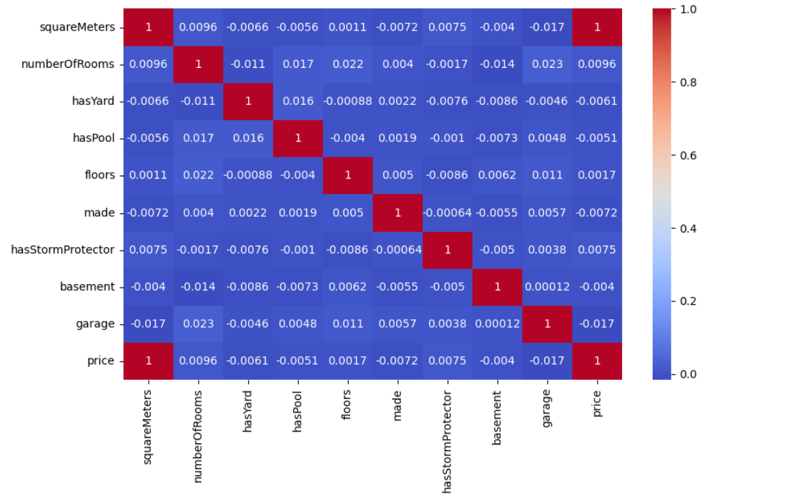
Heatmap Correlation

Slide 7
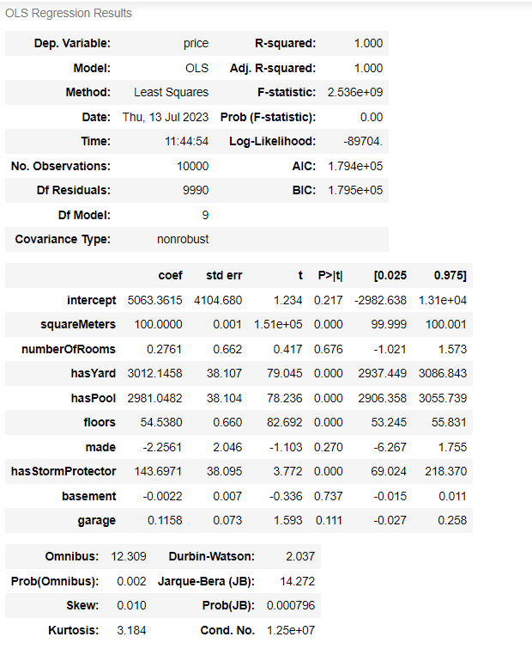
Outline of findings

Slide 8
The value of R2 is 1.00. So, 100% of the variation is explained by this model. The condition number is large which might suggest strong multicolinnearity. So we don't need all the variables to explain the variance. So now i reduce variables and run a multiple linear regression model on those variables with p - value 0.05 or less.

Slide 9
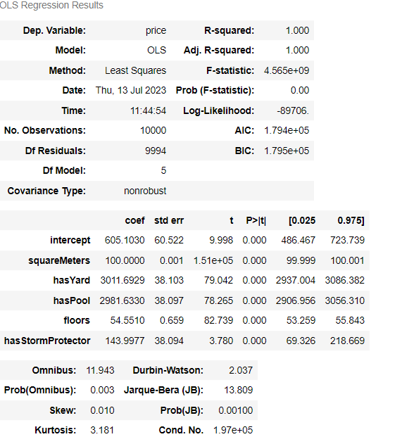

Slide 10
An explanation of the limitations of the techniques and tools used
Python
Disadvantages: High-level programming language that can be slower than other languages when it comes to execution.
Multiple Regression techniques
Disadvantages: Sensitive to outliers, and prominent observations, which can misrepresent the regression line and affect the parameter values.

Slide 11
Summary of proposed actions
More past data is needed as we don't know when the data was collected.
To provide clear understanding, more investigation is required to get more accurate result.

Slide 12
Expected benefits
Identification of important independent variables.
Prediction and forecasting.
Better detection tools.

Slide 13
Sources:
Tavish Aggarwal. (June, 2020). Limitations of the Linear Regression. Retrieved from https://www.techladder.in/article/limitations-linear-regression
What are the advantages and disadvantages of using multiple regression for quantitative analysis? (n.d). Retrieved from https://www.linkedin.com/advice/1/what-advantages-disadvantages-using-6c
Ken Feldman. (March, 2023). Step-by-Step Guide to Understanding and Using Multiple Regression in Your Research - isixsigma.com

Slide 14
Thank You

